Slide 1
Style space
-The art &craft of living
Team members:
k.Ratna kumari
k.Vani Chandrika
K.amrutha
k.Eesha manogna

Slide 2
Problem statement
Finding verified designers and personalized interior designs is challenging. Existing platforms lack seamless designer-client collaboration and customization. Style Spacing bridges this gap by offering room-specific designs, designer listings, and tailored styling. Our platform ensures a seamless experience for both clients and designers.
Description
The interior design industry lacks a centralized platform for verified designers and personalized styling. Clients struggle to find trusted professionals and explore room-specific designs tailored to their needs. Designers face challenges in showcasing their work and connecting with potential clients. Existing platforms offer limited customization and fragmented services, making collaboration difficult. Style Spacing bridges this gap by providing a one-stop solution for seamless designer-client interaction, tailored designs, and enhanced accessibility.

Slide 3
Technologies used: HTML (HyperText Markup Language)
Defines the structure of web pages, such as headers, sections, and navigation.
Creates the layout for room-specific designs, designer profiles, and customization options.
Forms are used for user sign-ups, designer registrations, and contact requests.
CSS (Cascading Style Sheets)
Enhances the visual design by styling elements like fonts, colors, and layouts.
Implements a modern and UI, ensuring a smooth experience across devices.
Provides grid and flexbox layouts for displaying designer portfolios and design inspirations attractively.
JavaScript (JS)
Adds interactivity and enhances user experience.
Enables dynamic filtering and searching of room designs and designer profiles.
Handles form validation, interactive galleries, and animations for smooth navigation.

Slide 4
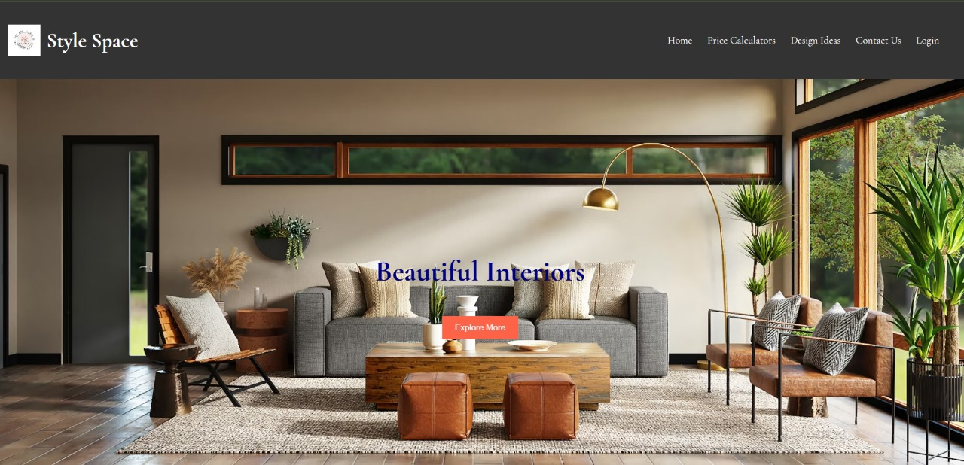
About the interface
H
Home page

Slide 5
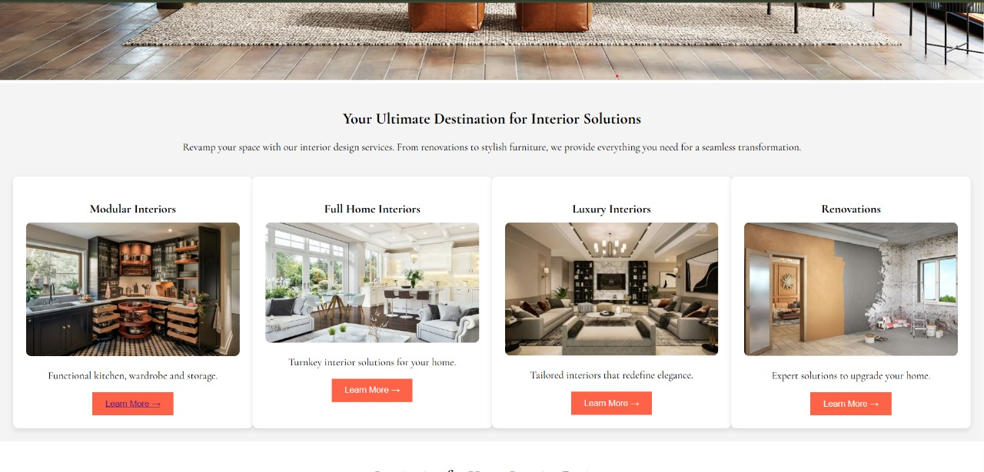
Had reference interior designs for multiple sections of home

Slide 6
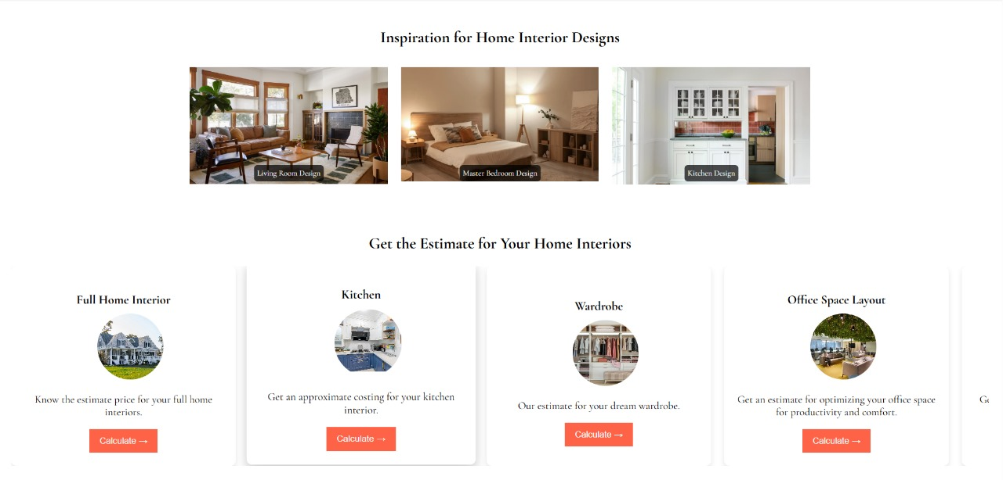
had multiple design references for diffiernt sections of home
And we can calculate the price estimation for the designing

Slide 7
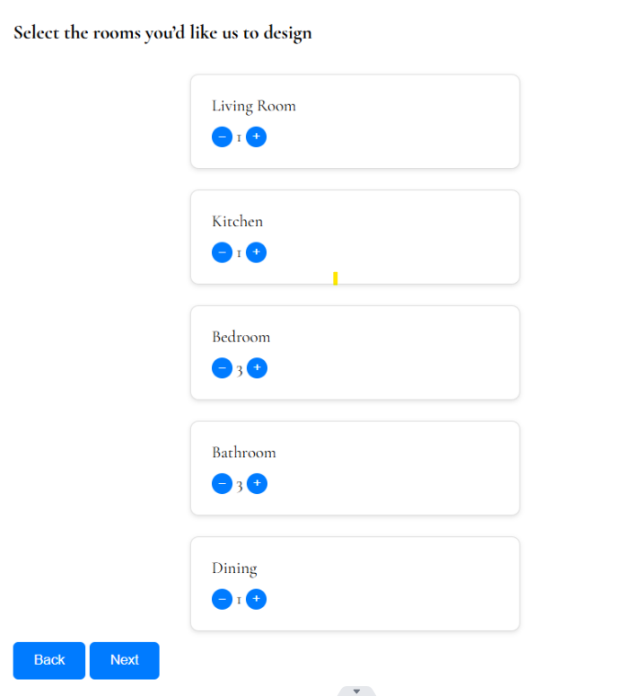
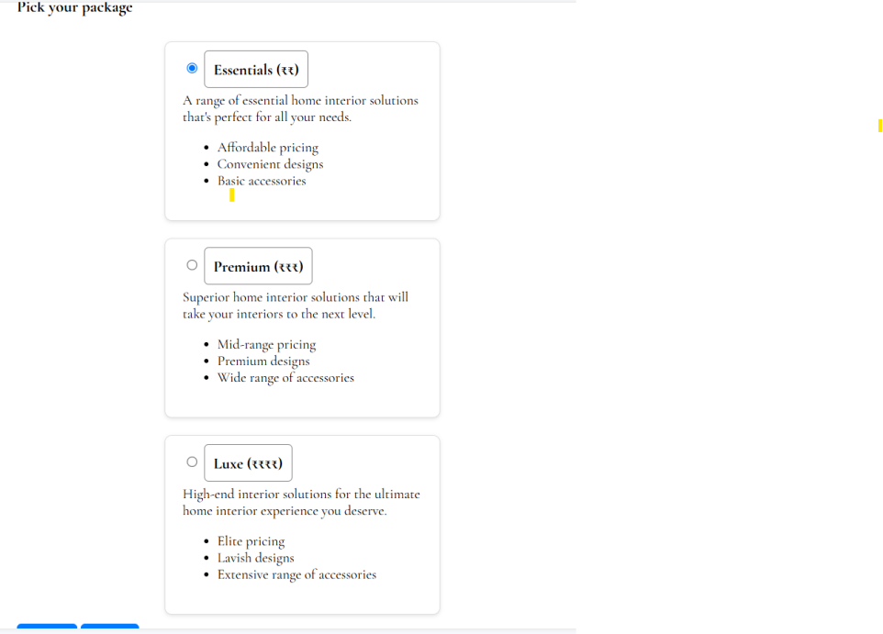
Further pages in price calculation:

Slide 8
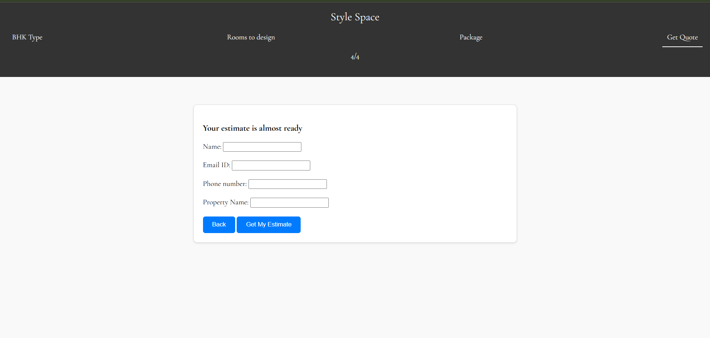
Budget estimation

Slide 9
How angular js is incorporated in stylespace
Component-Based Architecture – AngularJS enables a modular approach, making it
easy to manage different sections like room designs, designer listings, and user dashboards.
2.Dynamic Data Binding – Ensures real-time updates, allowing users to instantly see changes in design recommendations, filters, and selections.
3.Single Page Application (SPA) – Enhances user experience with smooth navigation, reducing page reloads while exploring designs or contacting designers.
4.REST API Integration – Fetches and displays designer profiles, user preferences, and design data efficiently from the backend.
5.Form Handling & Validation – Ensures seamless user registration, login, and custom design requests with real-time validation and error handling.

